Slide 1
CSE 4109: Artificial Intelligence
Fuzzy Systems: Fuzzy Logic Preliminaries
M.M.A. Hashem, PhD
Professor
Dept. of Computer Science and Engineering
Khulna University of Engineering & Technology (KUET)
Khulna 9203, Bangladesh
Email: hashem@cse.kuet.ac.bd

Slide 2
Today’s Lecture
Introduction, or what is fuzzy thinking?
Fuzzy sets
Linguistic variables and hedges
Operations of fuzzy sets
Fuzzy rules
Summary

Slide 3
Introduction, or what is fuzzy thinking?
Experts rely on common sense when they solve
problems.
How can we represent expert knowledge that
uses vague and ambiguous terms in a computer?
Fuzzy logic is not logic that is fuzzy, but logic that
is used to describe fuzziness. Fuzzy logic is the
theory of fuzzy sets, sets that calibrate vagueness.
Fuzzy logic is based on the idea that all things
admit of degrees. Temperature, height, speed,
distance, beauty – all come on a sliding scale. The
motor is running really hot. Tom is a very tall guy.

Slide 4
Boolean logic uses sharp distinctions. It forces us to draw lines between members of a class and non- members. For instance, we may say, Tom is tall because his height is 181 cm. If we drew a line at 180 cm, we would find that David, who is 179 cm, is small. Is David really a small man or we have just drawn an arbitrary line in the sand?
Fuzzy logic reflects how people think. It attempts to model our sense of words, our decision making and our common sense. As a result, it is leading to new, more human, intelligent systems.

Slide 5
Fuzzy, or multi-valued logic was introduced in the 1930s by Jan Lukasiewicz , a Polish philosopher. While classical logic operates with only two values 1 (true) and 0 (false), Lukasiewicz introduced logic that extended the range of truth values to all real numbers in the interval between 0 and 1. He used a number in this interval to represent the possibility that a given statement was true or false. For example, the possibility that a man 181 cm tall is really tall might be set to a value of 0.86. It is likely that the man is tall. This work led to an inexact reasoning technique often called possibility theory.

Slide 6
Later, in 1937, Max Black published a paper called “Vagueness: an exercise in logical analysis”. In this paper, he argued that a continuum implies degrees. Imagine, he said, a line of countless “chairs”. At one end is a Chippendale. Next to it is a near-Chippendale, in fact indistinguishable from the first item. Succeeding “chairs” are less and less chair-like, until the line ends with a log. When does a chair become a log? Max Black stated that if a continuum is discrete, a number can be allocated to each element. He accepted vagueness as a matter of probability.

Slide 7
In 1965 Lotfi Zadeh, published his famous paper “Fuzzy sets”. Zadeh extended the work on possibility theory into a formal system of mathematical logic, and introduced a new concept for applying natural language terms. This new logic for representing and manipulating fuzzy terms was called fuzzy logic, and Zadeh became the Master of fuzzy logic.

Slide 8
Why fuzzy?
As Zadeh said, the term is concrete, immediate and descriptive; we all know what it means. However, many people in the West were repelled by the word fuzzy , because it is usually used in a negative sense.
Why logic?
Fuzziness rests on fuzzy set theory, and fuzzy logic is just a small part of that theory.

Slide 9
Fuzzy logic is a set of mathematical principles
for knowledge representation based on degrees
of membership.
Unlike two-valued Boolean logic, fuzzy logic is
multi-valued. It deals with degrees of
membership and degrees of truth. Fuzzy logic
uses the continuum of logical values between 0
(completely false) and 1 (completely true). Instead
of just black and white, it employs the spectrum of
colours, accepting that things can be partly true and
partly false at the same time.

Slide 10
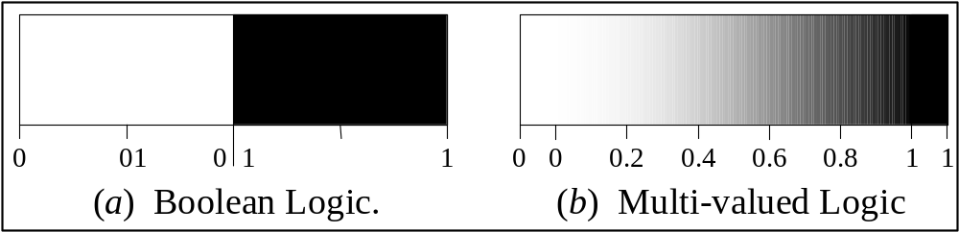
Range of logical values in Boolean and fuzzy logic
.

Slide 11
Fuzzy sets
The concept of a set is fundamental to mathematics.
However, our own language is also the supreme expression of sets. For example, car indicates the set of cars. When we say a car , we mean one out of the set of cars.

Slide 12
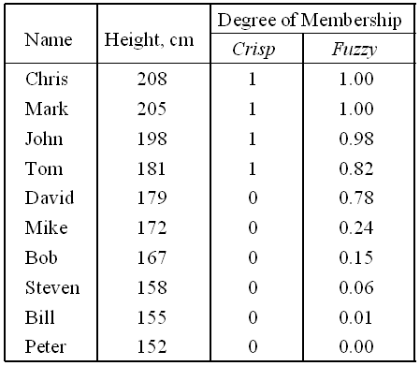
The classical example in fuzzy sets is tall men. The elements of the fuzzy set “tall men” are all men, but their degrees of membership depend on their height.

Slide 13
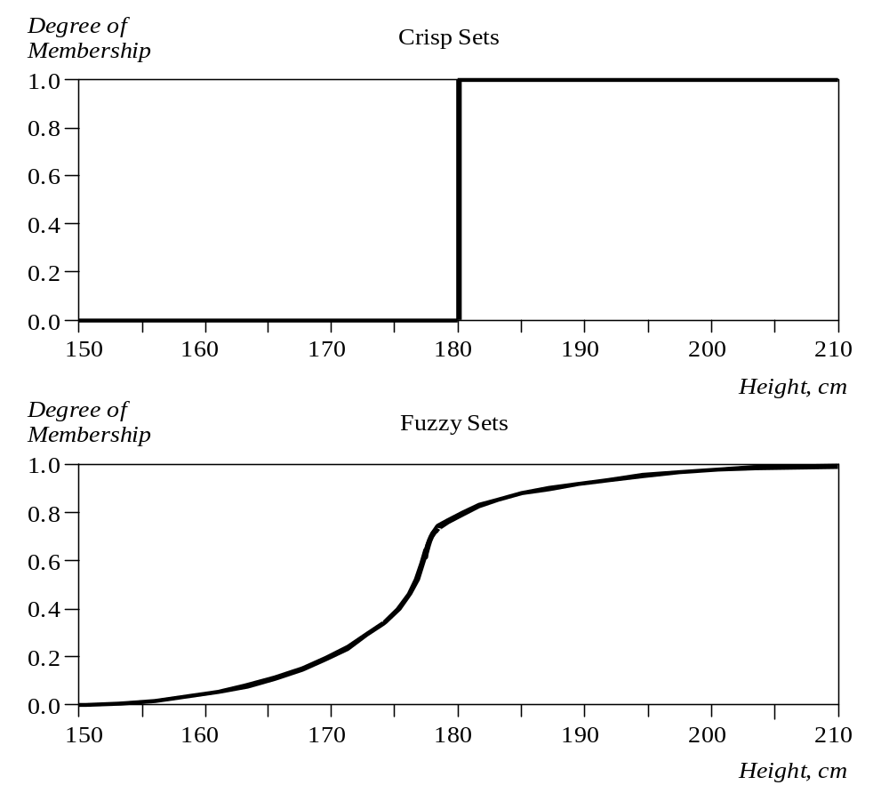
Crisp and fuzzy sets of “tall men”

Slide 14
The x-axis represents the universe of discourse – the range of all possible values applicable to a chosen variable. In our case, the variable is the man height. According to this representation, the universe of men’s heights consists of all tall men.
The y-axis represents the membership value of the fuzzy set. In our case, the fuzzy set of “tall men” maps height values into corresponding membership values.

Slide 15
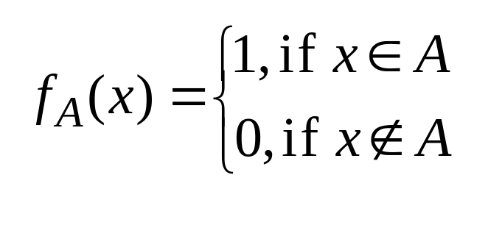
A fuzzy set is a set with fuzzy boundaries.
Let X be the universe of discourse and its elements be denoted as x. In the classical set theory, crisp set A of X is defined as function f_{A}(x) called the characteristic function of A
f_{A}(x): X  {0, 1}, where
This set maps universe X to a set of two elements.
For any element x of universe X, characteristic
function f_{A}(x) is equal to 1 if x is an element of set
A, and is equal to 0 if x is not an element of A.

Slide 16
In the fuzzy theory, fuzzy set A of universe X is defined by function _{A}(x) called the membership function of set A
μ_{A}(x): X → [0, 1], where μ_{A}(x) = 1 if x is totally in A;
μ_{A} (x) = 0 if x is not in A;
0 < μ_{A} (x) < 1 if x is partly in A.
This set allows a continuum of possible choices.
For any element x of universe X, membership
function μ_{A}(x) equals the degree to which x is an
element of set A. This degree, a value between 0
and 1, represents the degree of membership, also
called membership value, of element x in set A.

Slide 17
How to represent a fuzzy set in a computer?
First, we determine the membership functions. In our “tall men” example, we can obtain fuzzy sets of tall, short and average men.
The universe of discourse – the men’s heights – consists of three sets: short, average and tall men. As you will see, a man who is 184 cm tall is a member of the average men set with a degree of membership of 0.1, and at the same time, he is also a member of the tall men set with a degree of 0.4.

Slide 18
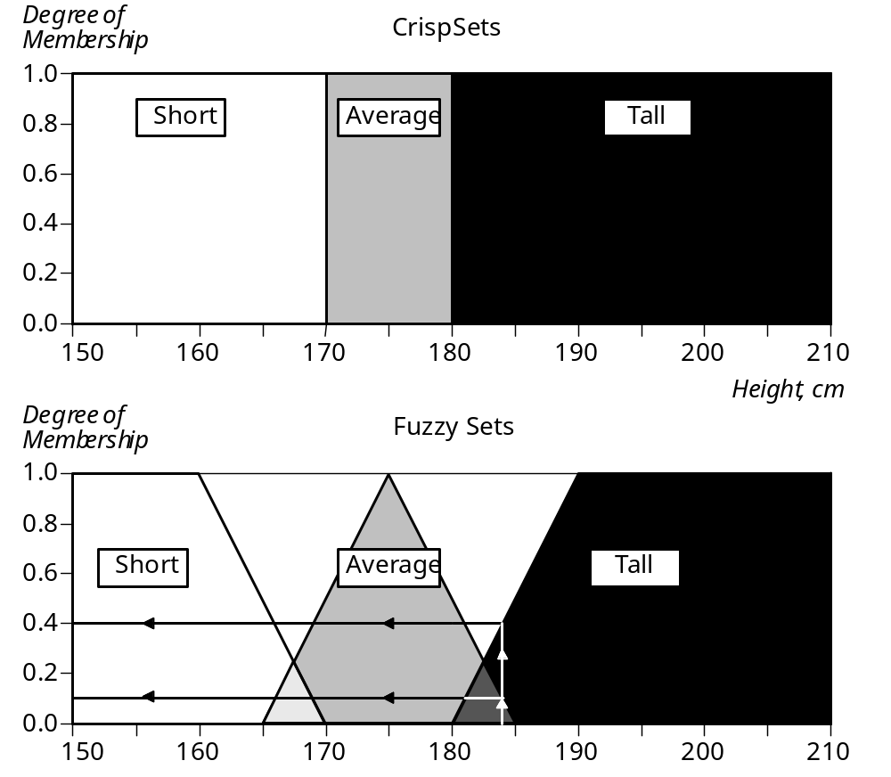
Crisp and fuzzy sets of short, average and tall men

Slide 19
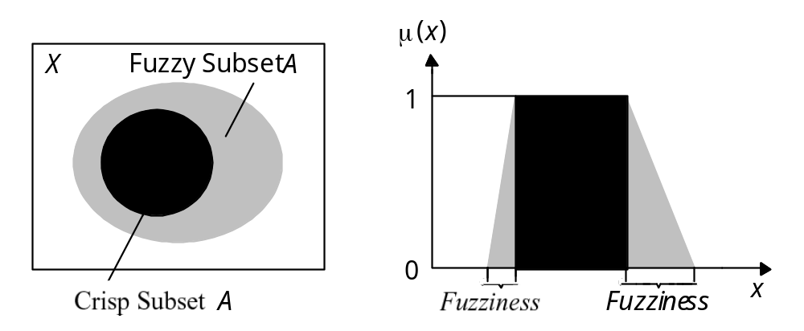
Representation of crisp and fuzzy subsets
Typical functions that can be used to represent a fuzzy
set are sigmoid, gaussian and pi. However, these
functions increase the time of computation. Therefore,
in practice, most applications use linear fit functions.

Slide 20
Linguistic variables and hedges
At the root of fuzzy set theory lies the idea of linguistic variables.
A linguistic variable is a fuzzy variable. For example, the statement “John is tall” implies that the linguistic variable John takes the linguistic value tall.

Slide 21
In fuzzy expert systems, linguistic variables are used
in fuzzy rules. For example:
IF wind is strong
THEN sailing is good
IF project_duration is long
THEN completion_risk is high
IF speed is slow
THEN stopping_distance is short

Slide 22
The range of possible values of a linguistic variable represents the universe of discourse of that variable. For example, the universe of discourse of the linguistic variable speed might have the range between 0 and 220 km/h and may include such fuzzy subsets as very slow, slow, medium, fast, and very fast.
A linguistic variable carries with it the concept of fuzzy set qualifiers, called hedges.
Hedges are terms that modify the shape of fuzzy sets. They include adverbs such as very, somewhat, quite, more or less and slightly.

Slide 23
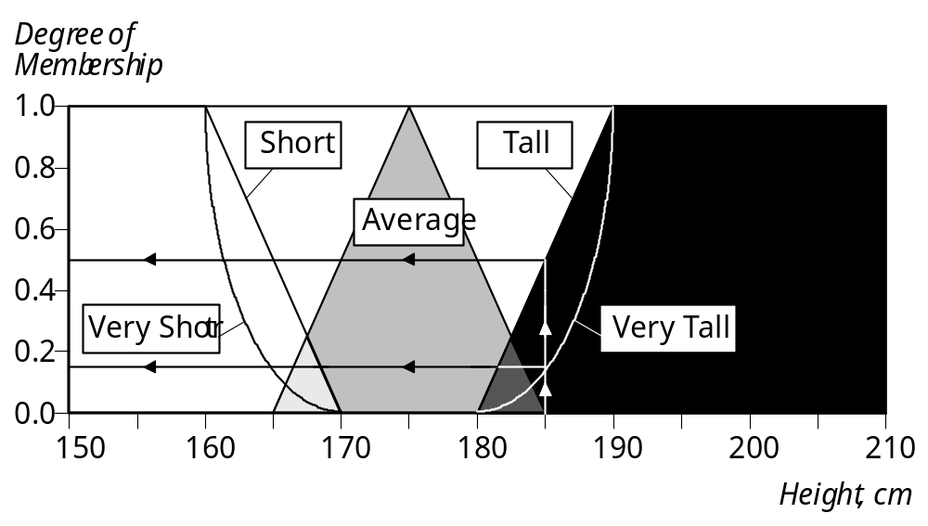
Fuzzy sets with the hedge very

Slide 24
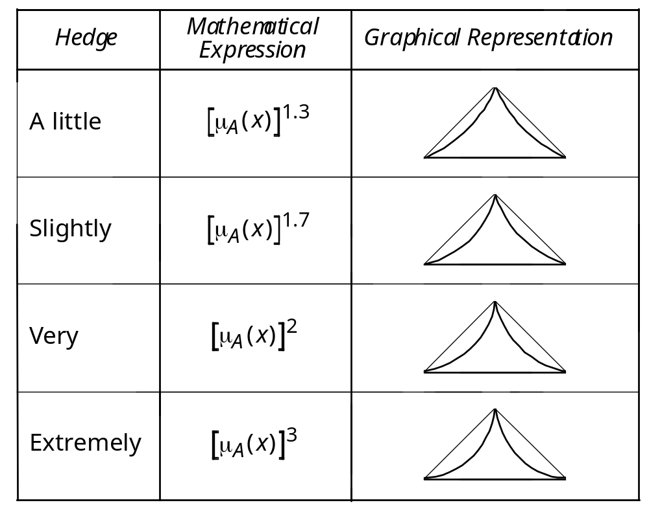
Representation of hedges in fuzzy logic

Slide 25
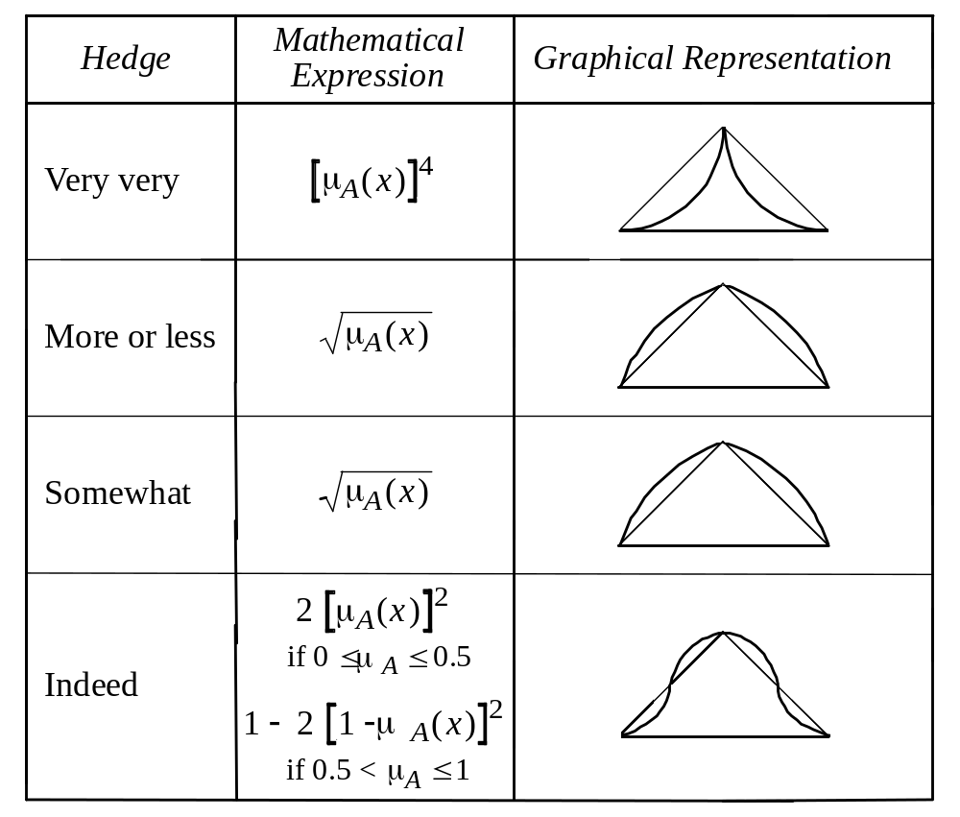
Representation of hedges in fuzzy logic (continued)

Slide 26
Operations of fuzzy sets
The classical set theory developed in the late 19th
century by Georg Cantor describes how crisp sets can
interact. These interactions are called operations.

Slide 27
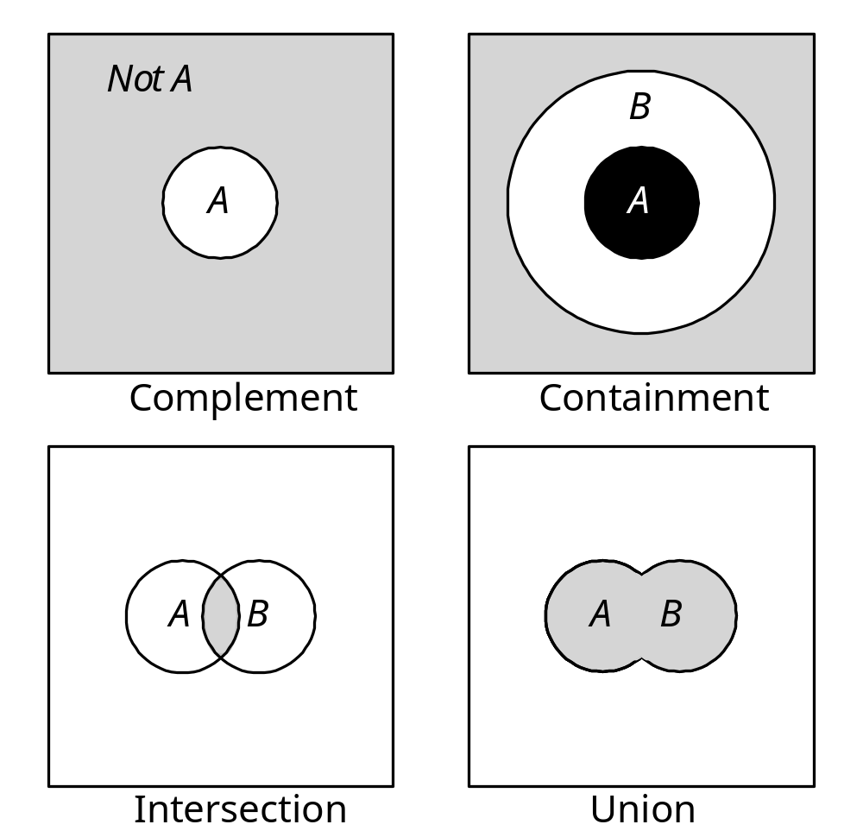
Cantor’s sets

Slide 28
Complement
Crisp Sets: Who does not belong to the set?
Fuzzy Sets: How much do elements not belong to
the set?
The complement of a set is an opposite of this set.
For example, if we have the set of tall men, its
complement is the set of NOT tall men. When we
remove the tall men set from the universe of
discourse, we obtain the complement. If A is the
fuzzy set, its complement ¬A can be found as
follows:
μ¬_{A}(x) = 1 − μ_{A}(x)

Slide 29
Containment
Crisp Sets: Which sets belong to which other sets?
Fuzzy Sets: Which sets belong to other sets?
Similar to a Chinese box, a set can contain other
sets. The smaller set is called the subset. For
example, the set of tall men contains all tall men;
very tall men is a subset of tall men. However, the
tall men set is just a subset of the set of men. In
crisp sets, all elements of a subset entirely belong to
a larger set. In fuzzy sets, however, each element
can belong less to the subset than to the larger set.
Elements of the fuzzy subset have smaller
memberships in it than in the larger set.

Slide 30
Intersection
Crisp Sets: Which element belongs to both sets?
Fuzzy Sets: How much of the element is in both sets?
In classical set theory, an intersection between two sets contains the elements shared by these sets. For example, the intersection of the set of tall men and the set of fat men is the area where these sets overlap. In fuzzy sets, an element may partly belong to both sets with different memberships. A fuzzy intersection is the lower membership in both sets of each element. The fuzzy intersection of two fuzzy sets A and B on universe of discourse X:
μ_{A}∩_{B}(x) = min [μ_{A} (x), μ_{B} (x)] = μ_{A} (x) ∩ μ_{B}(x),
where x∈X

Slide 31
Union
Crisp Sets: Which element belongs to either set?
Fuzzy Sets: How much of the element is in either set?
The union of two crisp sets consists of every element
that falls into either set. For example, the union of
tall men and fat men contains all men who are tall
OR fat. In fuzzy sets, the union is the reverse of the
intersection. That is, the union is the largest
membership value of the element in either set. The
fuzzy operation for forming the union of two fuzzy
sets A and B on universe X can be given as:
μ_{A}∪_{B}(x) = max [μ_{A} (x), μ_{B}(x)] = μ_{A} (x) ∪ μ_{B}(x),
where x∈X

Slide 32
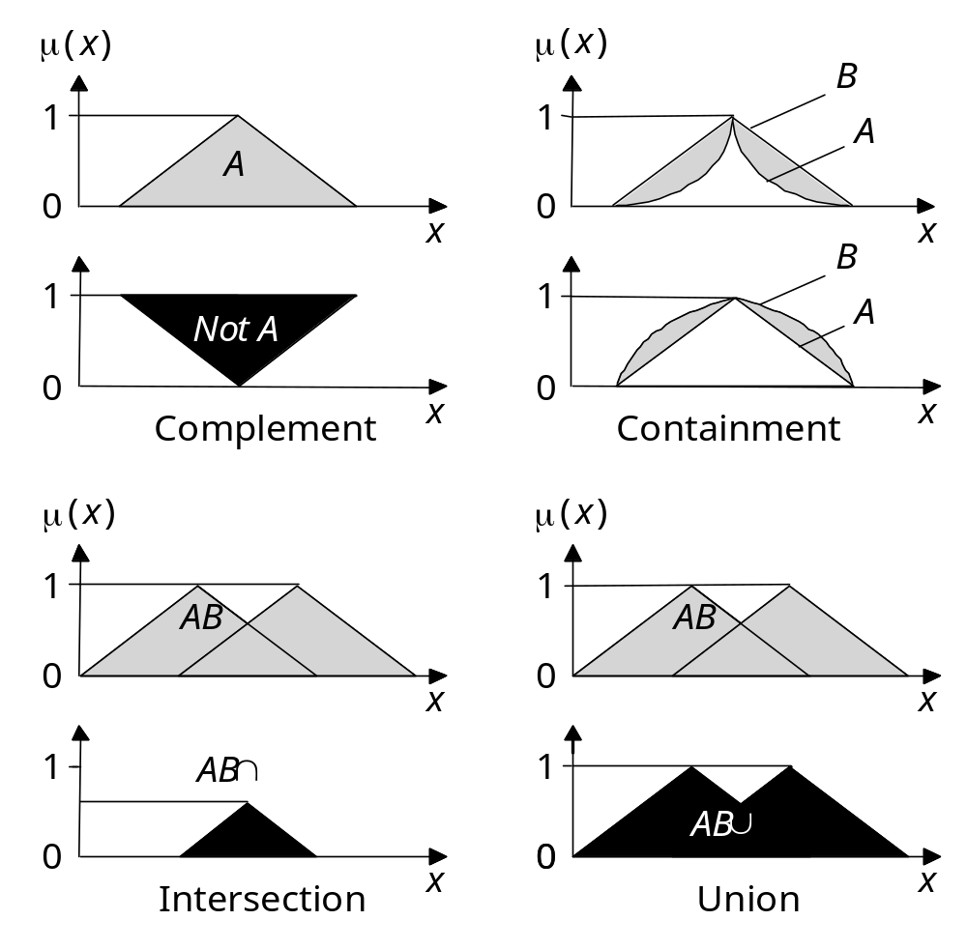
Operations of fuzzy sets

Slide 33
Fuzzy rules
In 1973, Lotfi Zadeh published his second most
influential paper. This paper outlined a new
approach to analysis of complex systems, in which
Zadeh suggested capturing human knowledge in
fuzzy rules.

Slide 34
What is a fuzzy rule?
A fuzzy rule can be defined as a conditional
statement in the form:
IF x is A
THEN y is B
where x and y are linguistic variables; and A and B
are linguistic values determined by fuzzy sets on the
universe of discourses X and Y, respectively.

Slide 35
What is the difference between classical and
fuzzy rules?
A classical IF-THEN rule uses binary logic, for example,
Rule: 1 Rule: 2
IF speed is > 100 IF speed is < 40
THEN stopping_distance is long THEN stopping_distance is short
The variable speed can have any numerical value
between 0 and 220 km/h, but the linguistic variable
stopping_distance can take either value long or short.
In other words, classical rules are expressed in the
black-and-white language of Boolean logic.

Slide 36
We can also represent the stopping distance rules in a
fuzzy form:
Rule: 1 Rule: 2
IF speed is fast IF speed is slow
THEN stopping_distance is long THEN stopping_distance is short
In fuzzy rules, the linguistic variable speed also has
the range (the universe of discourse) between 0 and
220 km/h, but this range includes fuzzy sets, such as
slow, medium and fast. The universe of discourse of
the linguistic variable stopping_distance can be
between 0 and 300 m and may include such fuzzy
sets as short, medium and long.

Slide 37
Fuzzy rules relate fuzzy sets.
In a fuzzy system, all rules fire to some extent, or in other words they fire partially. If the antecedent is true to some degree of membership, then the consequent is also true to that same degree.

Slide 38
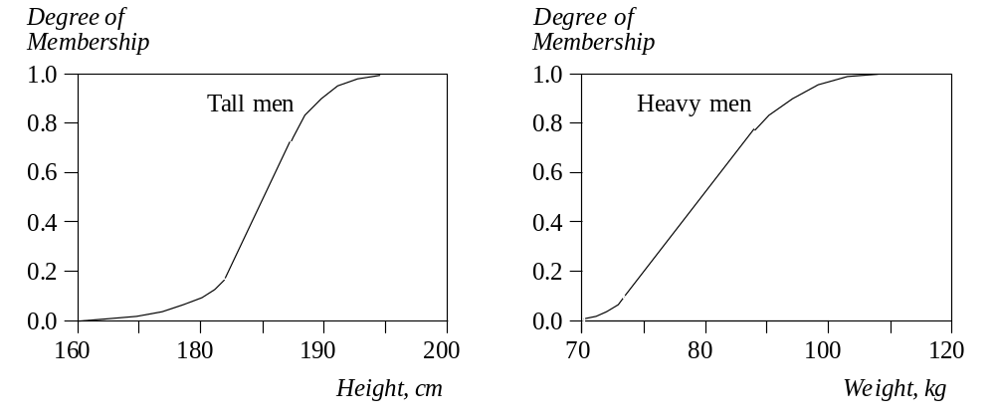
Fuzzy sets of tall and heavy men
These fuzzy sets provide the basis for a weight estimation
model. The model is based on a relationship between a
man’s height and his weight:
IF height is tall
THEN weight is heavy

Slide 39
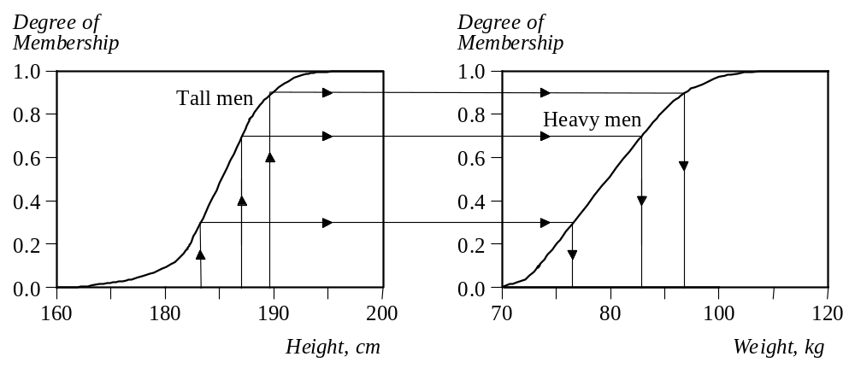
The value of the output or a truth membership grade of
the rule consequent can be estimated directly from a
corresponding truth membership grade in the
antecedent. This form of fuzzy inference uses a
method called monotonic selection.

Slide 40
A fuzzy rule can have multiple antecedents, for
example:
IF project_duration is long
AND project_staffing is large
AND project_funding is inadequate
THEN risk is high
IF service is excellent
OR food is delicious
THEN tip is generous

Slide 41
The consequent of a fuzzy rule can also include multiple parts, for instance:
IF temperature is hot
THEN hot_water is reduced;
cold_water is increased

